Slide 1

https://youtu.be/zHhTZURgxTY
UNIVERSITI TEKNOLOGI MALAYSIA
NAME : Safira Nurul Izza
MATRIC : MCS241009
PROJECT : Project 1
PROJECT TITLE: Analyzing Player Feedback in Steam Review Across Game Genres

Slide 2
INTRODUCTION

Slide 3

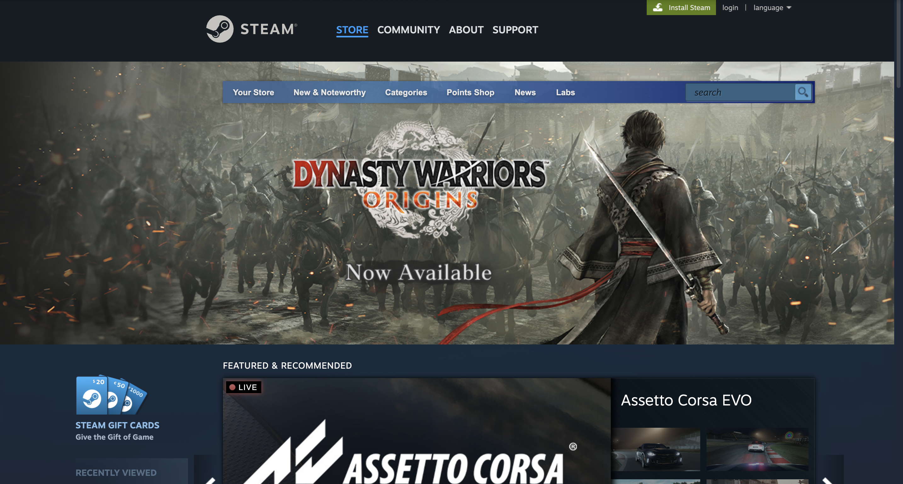
Steam is one of the most popular digital video game distribution platforms to buy and play videos games.

Slide 4
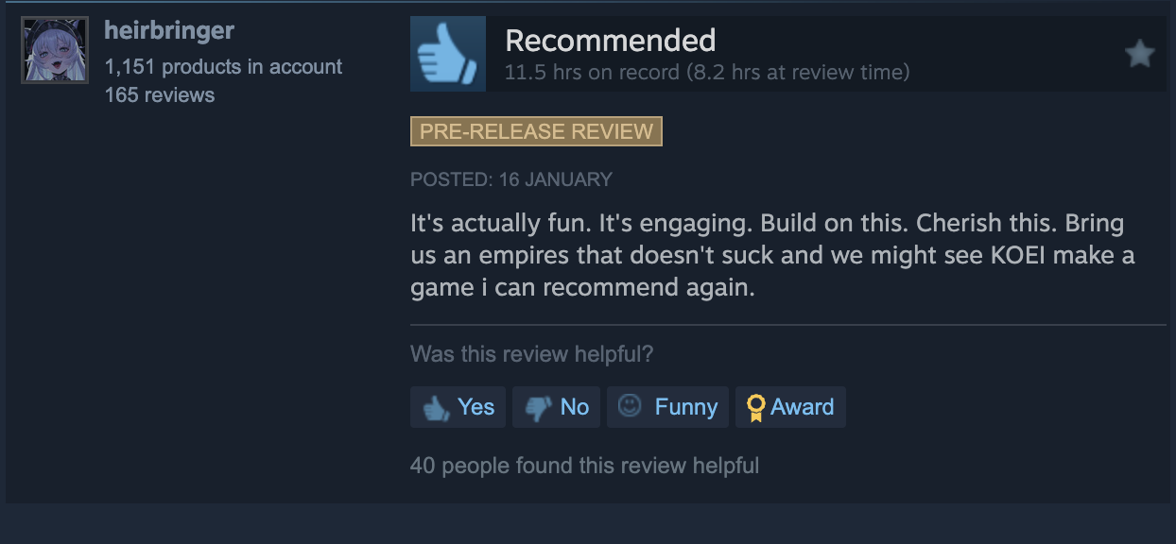
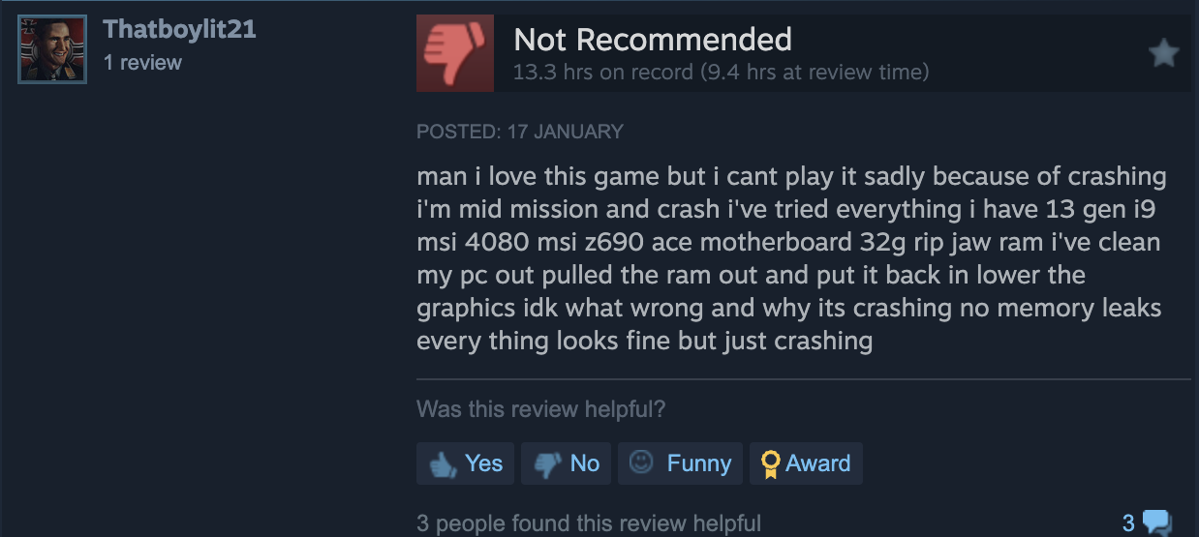
The binary review system ("Recommended" or "Not Recommended") limits detailed feedback analysis.

Slide 5
Game Genre Overview
Genre | Definition
Action | Emphasizes fast-paced gameplay with physical challenges like reflexes and coordination.
RPG (Role-Playing Game) | Story-driven games focusing on character development and customization.
FPS (First-Person Shooter) | Combat-focused games viewed through the player's eyes.
Strategy | Tactical games requiring planning and resource management.
Indie | Developed by small teams or individuals without major publishers.

Slide 6
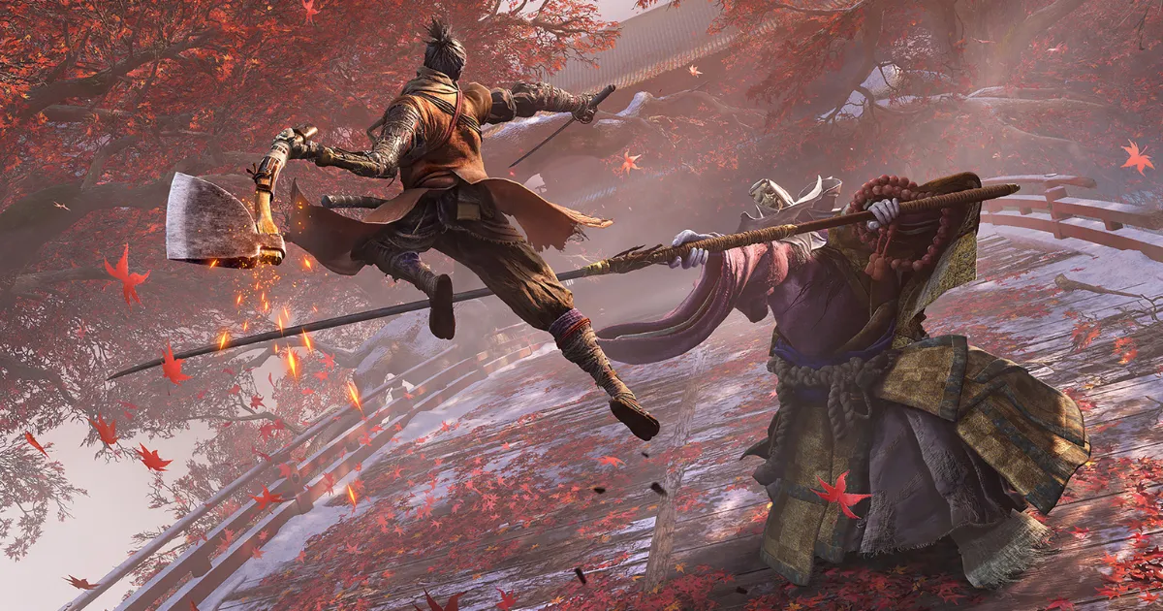
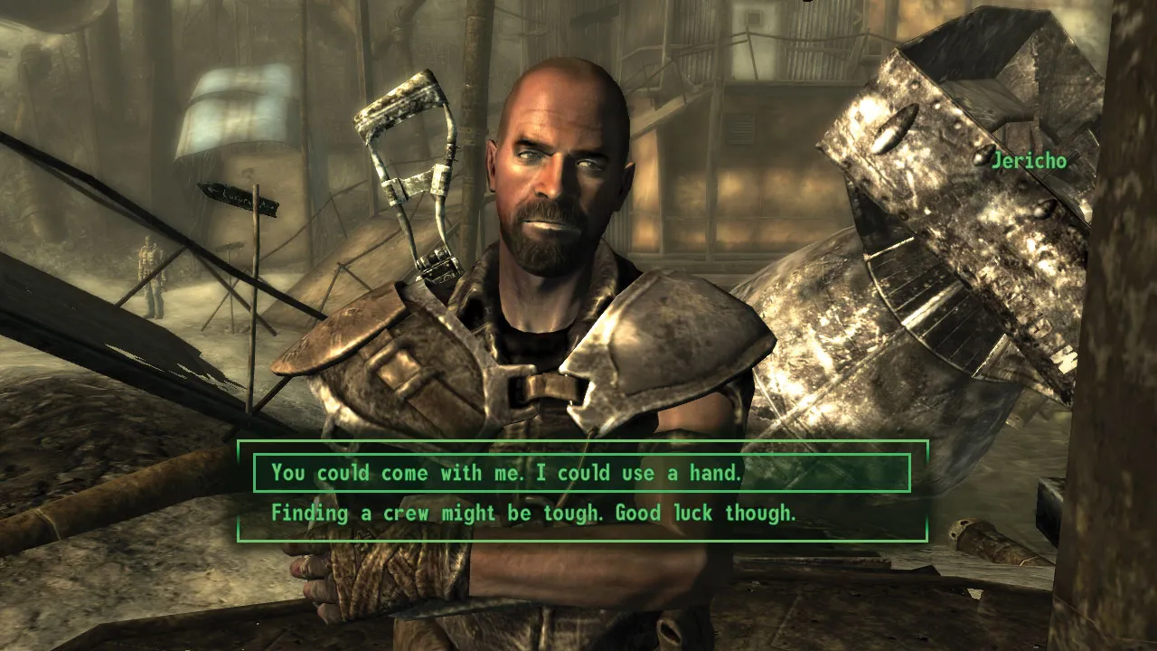
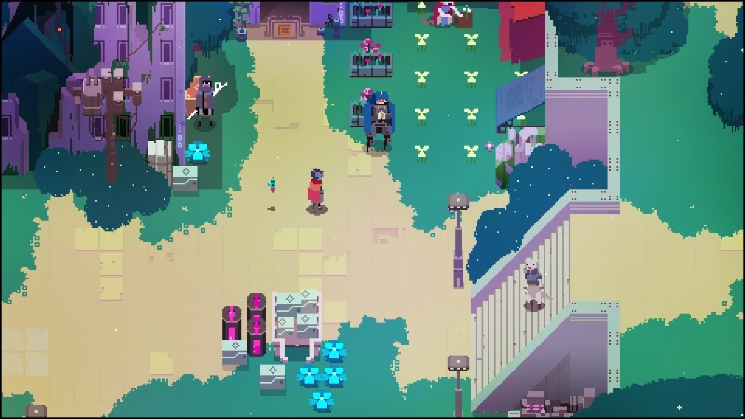


Each game genre caters to different player preferences and expectations.

Slide 7
PROBLEM BACKGROUND
Steam's review system lacks detail for developers to understand player preferences.
Large-scale data from reviews is impractical for manual analysis.
Challenges in understanding mixed sentiments and genre-specific expectations.

Slide 8
Research Questions
How can sentiment analysis provide deeper insights into player feedback?
How do reviews differ across game genres?
What game elements (e.g., graphics, story) are most frequently mentioned in feedback?
Objectives
Analyze positive/negative review proportions.
Identify trends and actionable insights.
Explore relationships between game elements and sentiments.

Slide 9
LITERATURE REVIEW

Slide 10
Literature Review
Sentiment Analysis Methods
Data Collection Methods
Tools/Platforms
Lexicon-Based Methods
Machine Learning Based Methods
Deep Learning Based Methods
Hybrid Methods
Aspect-Based Sentiment Analysis
Web Scraping
APIs
Dataset Repository
Google Colaboratory
Jupyter Notebook

Slide 11
RESEARCH METHODOLOGY

Slide 12
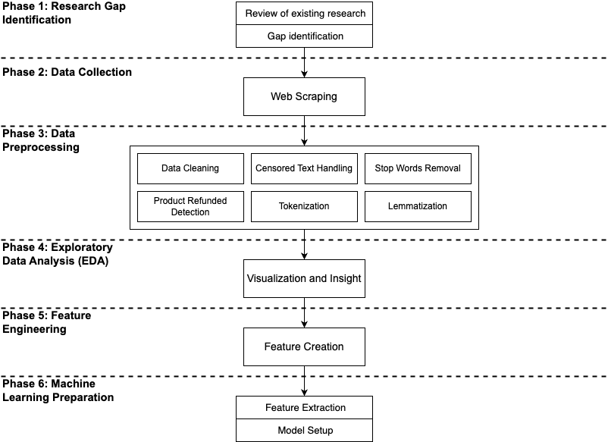
Research Framework

Slide 13
Tools and Technologies Used in the Study
Tool/Technology | Purpose
Steam Community | Primary data source for player reviews.
Python | Used for coding and data processing.
Selenium | Web scraping tool to collect data from Steam reviews.
Microsoft WebDriver | Automates browser interactions for Selenium.
Jupyter Notebook | Platform for writing and executing Python code.

Slide 14
List of the Selected Games (100,000 review data)
Title | Game Name | Game ID
Action | Red Dead Redemption 2 | 1174180
 | Sekiro™: Shadows Die Twice - GOTY Edition | 814380
 | Lies of P | 1627720
 | Mortal Kombat 1 | 1971870
 | God of War | 1593500
First-Person Shooter | Call of Duty® | 1938090
 | Borderlands 3 | 397540
 | Metro Exodus | 412020
 | PUBG: BATTLEGROUNDS | 578080
 | S.T.A.L.K.E.R. 2: Heart of Chornobyl | 1643320
Role Playing Game | DAVE THE DIVER | 1868140
 | Fear & Hunger | 1002300
 | Fallout 4 | 377160
 | DREDGE | 1562430
 | Persona 5 Royal | 1687950
Strategy | Balatro | 2379780
 | Dwarf Fortress | 975370
 | Hearts of Iron IV | 394360
 | Planet Zoo | 703080
 | Age of Empires II: Definitive Edition | 813780
Indie | Undertale | 391540
 | Mouthwashing | 2475490
 | Unpacking | 1135690
 | MiSide | 2527500
 | Stardew Valley | 413150

Slide 15
Data Cleaning
Remove Missing Values: Checked and removed missing or null values in key columns (e.g., review content).
Duplicate Removal: Identified and removed duplicate reviews to ensure dataset integrity.
Non-English Reviews: Filtered out reviews written in languages other than English.
Non-Meaningful: Removed reviews with fewer than six alphanumeric characters.
Censored Text Handling: Replaced censored words (♥♥♥ emoticons) with “[censored]” for uniformity.
Product Refund Labels: Retained reviews labeled as "Product Refunded" to analyze dissatisfaction patterns.

Slide 16
Data Transformation
Text Normalization: Converted all text to lowercase to ensure uniformity.
Stop Word Removal: Removed commonly used words (e.g., "the," "and") using Natural Language Toolkit (NLTK).
Tokenization: Split text into smaller units (tokens) for structured analysis.
Lemmatization: Reduced words to their base forms (e.g., "playing" to "play") while preserving context.

Slide 17
INITIAL RESULTS

Slide 18
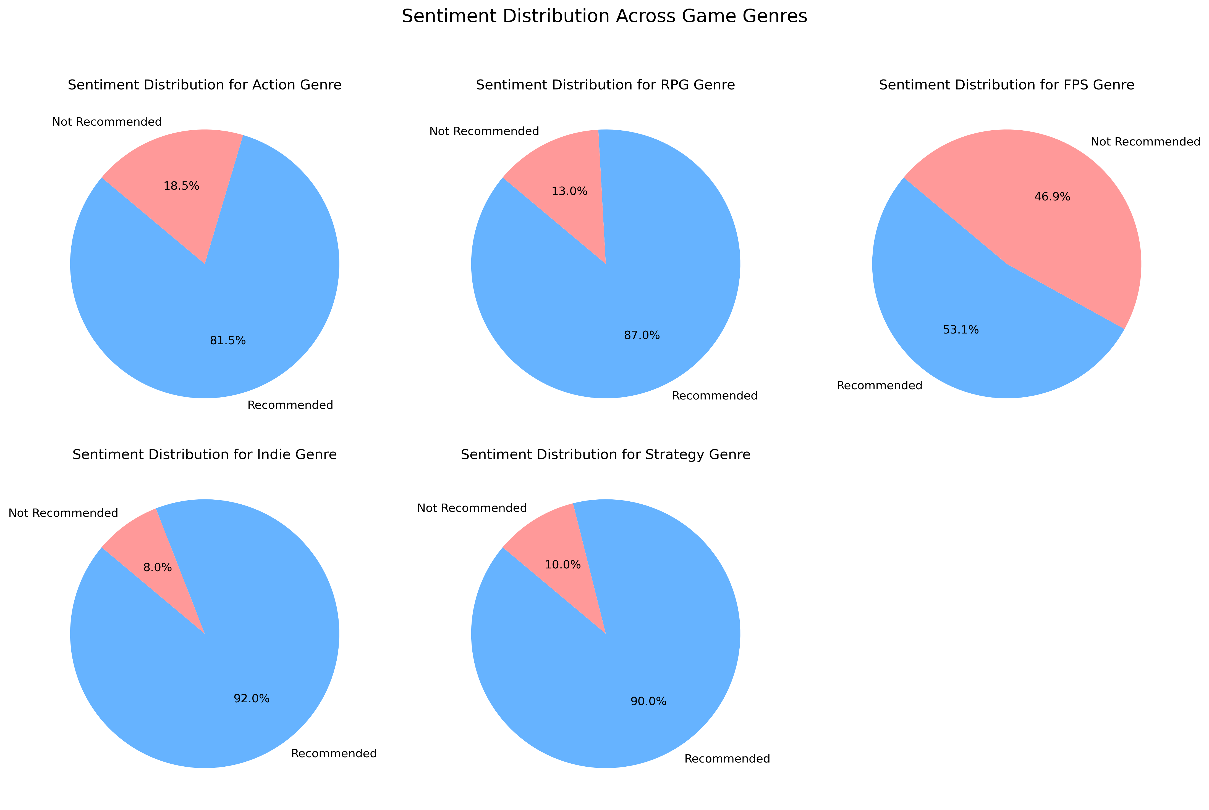
Sentiment Distribution Across Genres

Slide 19
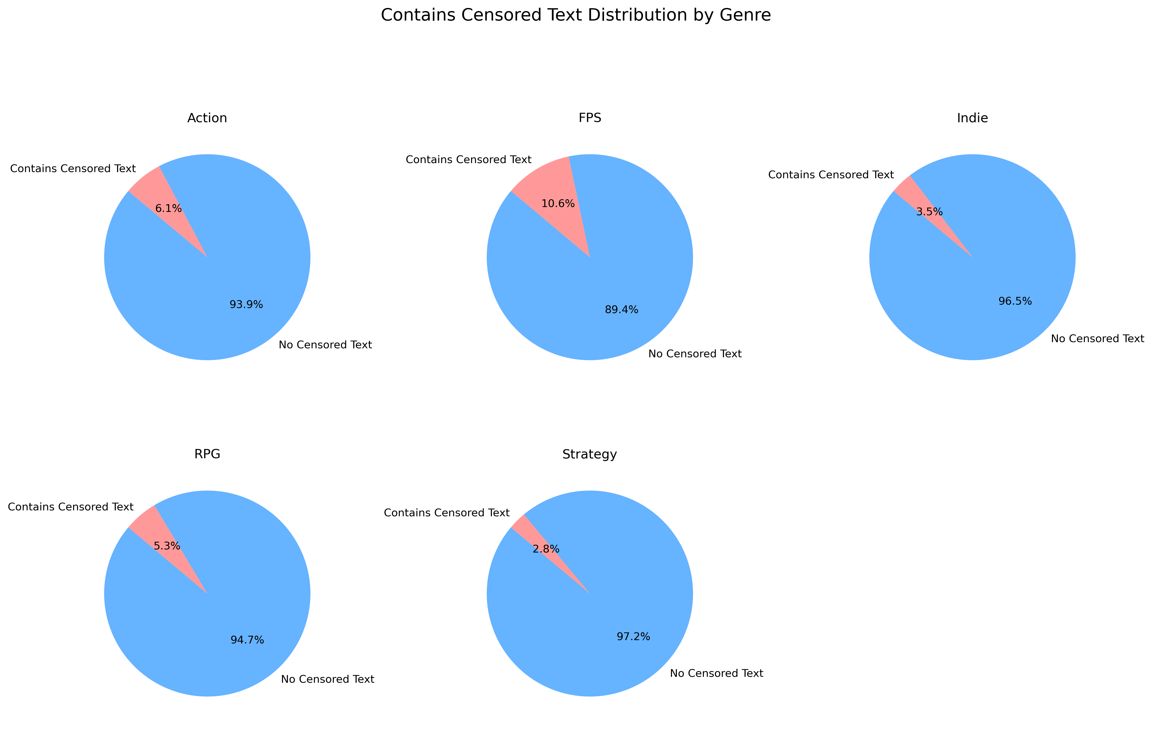
Distribution of Censored Text Across Genres

Slide 20
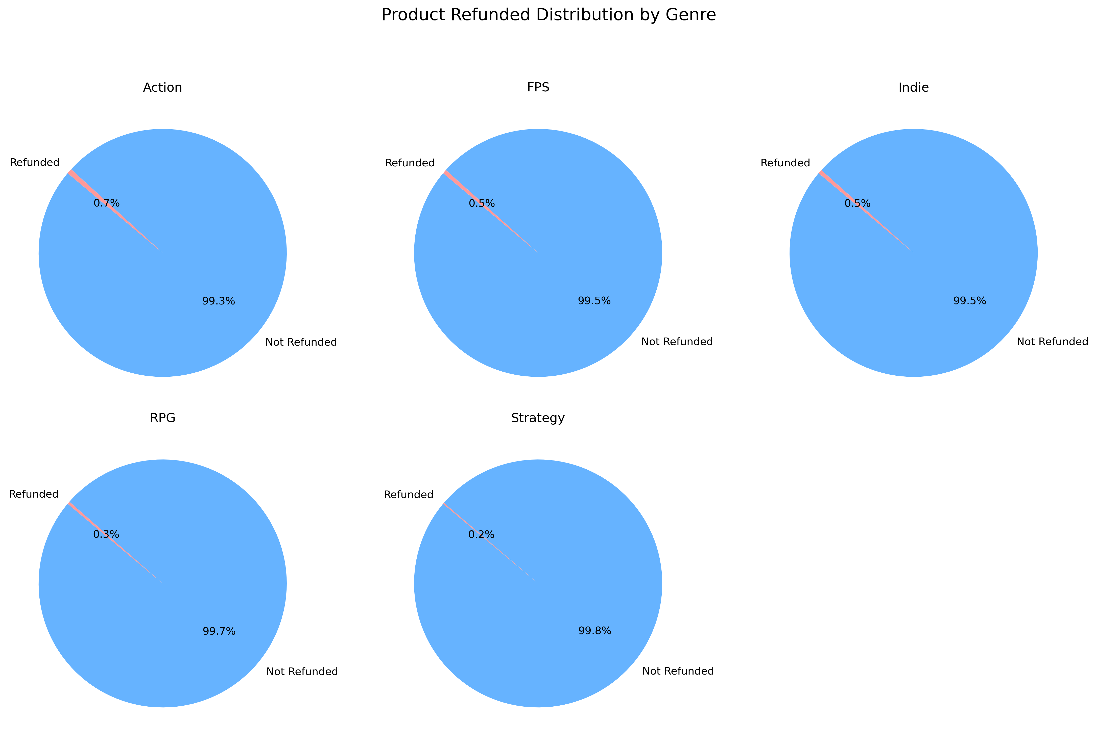
Distribution of Product Refunds Across Genres

Slide 21
Key Insights
Sentiment Distribution
FPS had the most negative reviews (46.9%), linked to dissatisfaction with graphics or performance.
Indie games had the least negative reviews (8%), reflecting high satisfaction.
Action, RPG, and Strategy genres had negative reviews below 20%.
Censored Text
FPS had the highest percentage of censored reviews (10.6%), showing frustration.
Strategy had the least censorship (2.8%).
Refund Requests
Action had the highest refund rate (0.7%), while Strategy had the lowest (0.2%).
Correlations
FPS showed the highest negative reviews, censorship, and refunds, indicating dissatisfaction.
Strategy exhibited the lowest, reflecting player satisfaction.

Slide 22
Feature Engineering
Feature | Description | Purpose
Sentiment Tone Score | Uses VADER to extract sentiment scores (positive, negative, neutral) from the Review Content column. | Enables genre-specific sentiment classification and comparison.
Review Length | Measures the length (number of characters) of each review. | Identifies correlations between review length and sentiment (e.g., longer reviews might have more detailed feedback).
Grouping of Playing Hours | Categorizes play hours into three levels: low, medium, and high engagement. | Simplifies comparison of player satisfaction across different engagement levels.
Time Pattern | Transforms the Date Posted column into a Month-Year format. | Helps analyze review trends over time and link them to events like updates or promotions.
Product Refunded | Flags reviews labeled as "Product Refunded" to indicate dissatisfaction leading to refunds. | Analyzes dissatisfaction patterns and identifies reasons for refund requests.
Censored Text | Identifies reviews with censored words (♥♥♥ symbol) and replaces them with a placeholder ("[censored]"). | Captures emotional nuances in reviews and explores correlations between censored language and sentiment.

Slide 23


Thank You.
utmofficial
univteknologimalaysia
utm.my

